Slide 1
Warm Up
Multiply. Write each fraction in simplest form.
1. × 2. ×
Write each fraction as a decimal.
3. 4.
2 5
3 5
6 25
1 6
3 4
1 8
2 5
32 125
0.4
0.256

Slide 2
38.1 Probability Single event

Slide 6
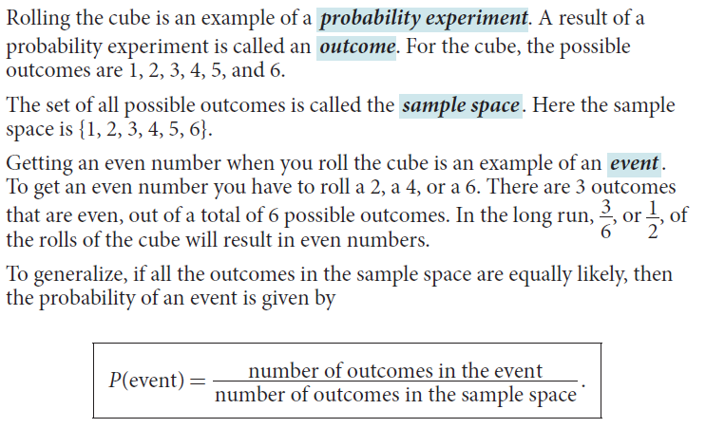

Slide 8
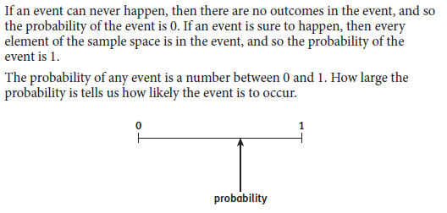

Slide 10
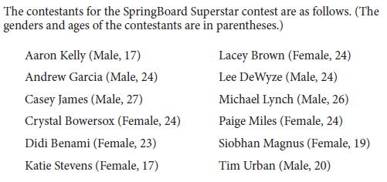

Slide 13
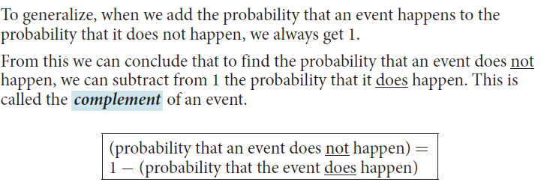

Slide 14
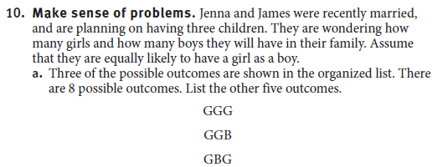

Slide 16
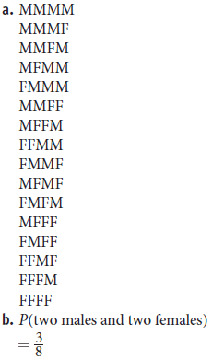

Slide 17
38.2 Events involving “And” and “or”

Slide 19
Remember that in probability, the set of
all possible outcomes of an experiment
is called the sample space. Any set of
outcomes is called an event.
If every outcome in the sample space is
equally likely, the theoretical probability
of an event is

Slide 20
A compound event is made up of one or more separate events. To find the probability of a compound event, you need to know if the events are independent or dependent.
Events are independent events if the occurrence of one event does not affect the probability of the other. Events are dependent events if the occurrence of one does affect the probability of the other.

Slide 21
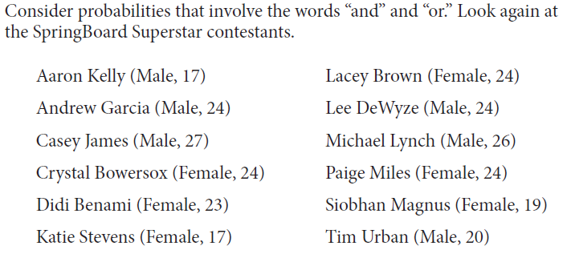
We are starting with only independent events

Slide 22
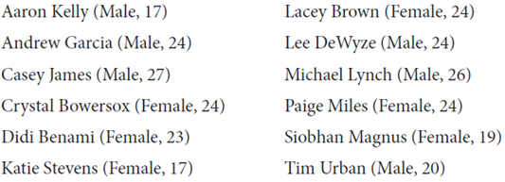

Slide 27
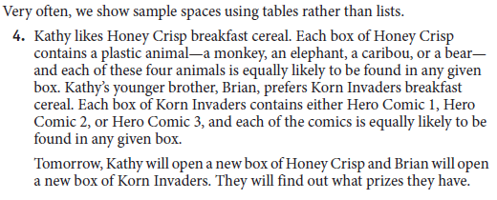

Slide 28
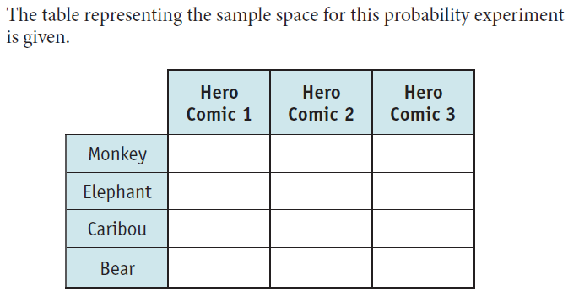
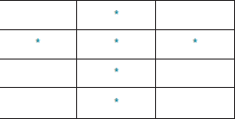

Slide 29
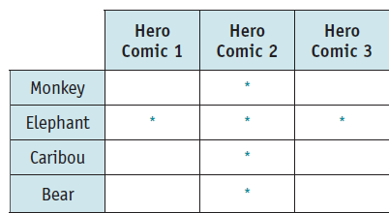

Slide 30
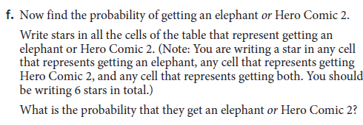

Slide 31
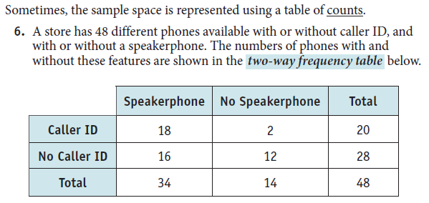

Slide 34
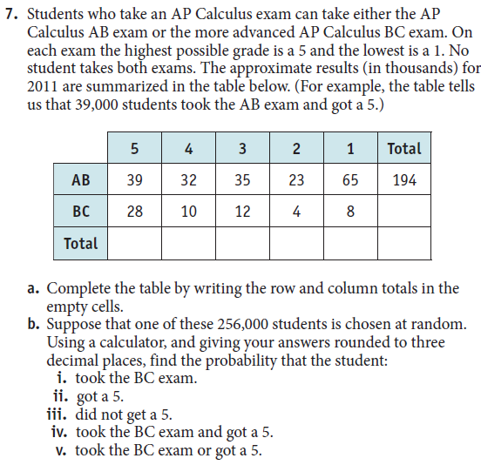

Slide 35
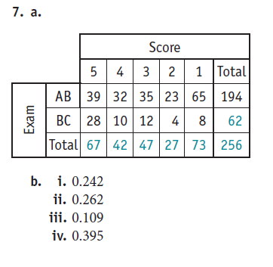

Slide 36
INDEPENDENT EVENTS

